Slide 1

AI based Document Image Processing for OCR (Robust OCR)
Interns:
Gade Manasa
Ashutosh Singh
Piyush Sharma
S Sarathchandran
N.Sai Satya Harika
Mentors:
Dr. Nidhi Chahal
Dr. Manoj Sharma

Slide 2

CONTENT
Introduction
Related Work
Contribution
Proposed Work
Datasets
Methodology
Experimental Results
Conclusion
References

Slide 3
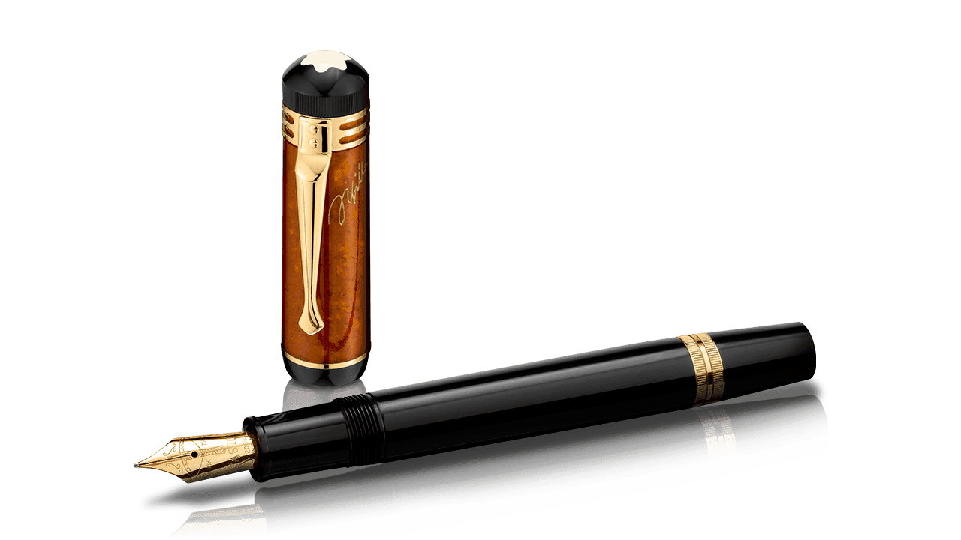
INTRODUCTION
OCR (Optical character recognition) technologies work well for high quality document images , but face problems in recognizing text when the document images are of low-resolution, or very noisy or degraded.
The main reason behind this is that the training data given to OCR is noise-free or high-resolution.
Therefore, for a noisy or degraded or low-resolution image is subjected to different preprocessing techniques prior to passing it to an OCR system.
Traditional image enhancement techniques utilize a de-noising technique prior to super-resolution (SR) process, as super-resolution without denoising makes the noise even more significant.
But in such cascaded pre-processing pipelines, de-noising smooth's the image and in process removes important textures and high-frequency details. This leads to inaccuracies in document binarization, image segmentation and text recognition.
In this presentation we counter this problem by training a network to jointly remove noise while super-resolving the text image. This enables the text image to preserve the required high-frequency information while removing the unnecessary noise.

Slide 4
RELATED WORK
There have been works around text image super-resolution [5], [6], [7], [8] and denoising [1], [2], [3] separately but a handful of work has been done to achieve both simultaneously [9].
Recently Ankit.et.al [13] has use GAN based architecture for super-resolution to get super-resolved text to boost OCR performance.
In [9] authors have proposed joint optimisation of two CNN based de-noising and SR module to improve OCR.
These above frameworks lack in generalisation capability in terms of different scripts,printed/handwritten, font-styles etc.
In all these frameworks, enhancement and recognition being two different modules in cascaded manner are unable to refine enhancement module weights to get more precise recognition results.

Slide 5
CONTRIBUTION
Framework that jointly optimizes image-denoising and super-resolution of degraded document images.
Use of cycle consistency loss [14] to refine HR target document image.
Joint optimization of document image enhancement and recognition for degraded document images through a end-to-end robust OCR framework to boost recognition accuracy.
Exhaustive experimentation with different types of data (printed and handwritten) in different scripts to show efficacy of proposed network and comparison with state-of-art frameworks for document image enhancement and recognition.

Slide 6
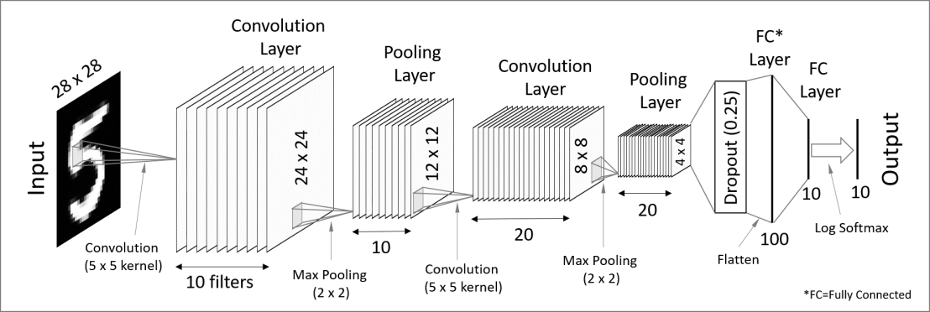
PROPOSED FRAMEWORK
End-to-End network architecture for joint optimization of document image enhancement and recognition.

Slide 7
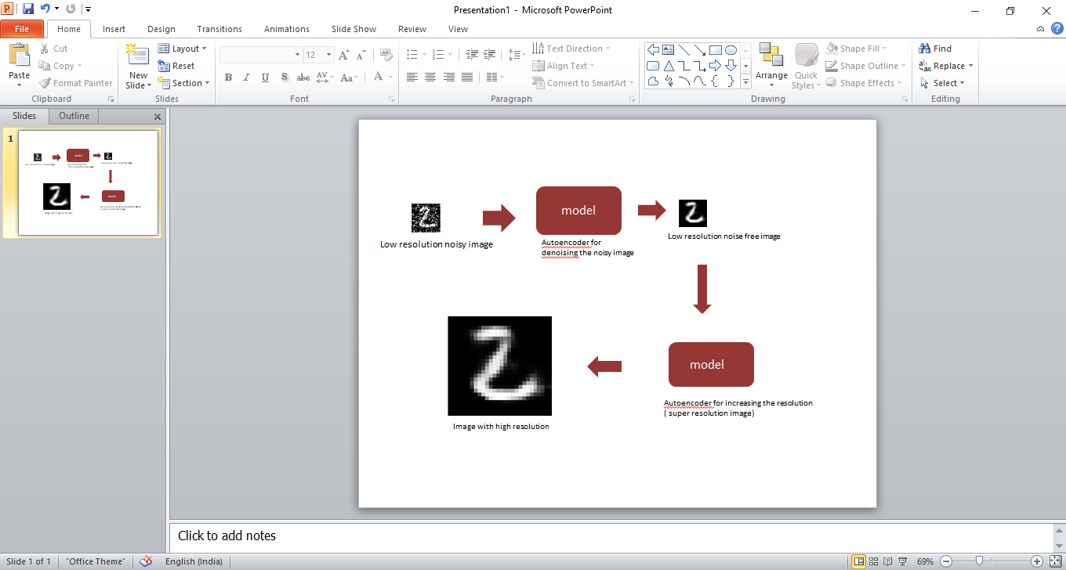
The proposed end-to-end network architecture for joint optimization of document image enhancement and recognition is shown in above figure. It comprises of two modules i.e., enhancement module and BLSTM-CTC based OCR module.
Cascaded Enhancement module architecture for joint optimization of document image denoising and super-resolution.
The low resolution image is passed through the model to denoise the noisy image which is again passed through the model to increase the resolution of the image. So, that the final output is an image with increased resolution.

Slide 8
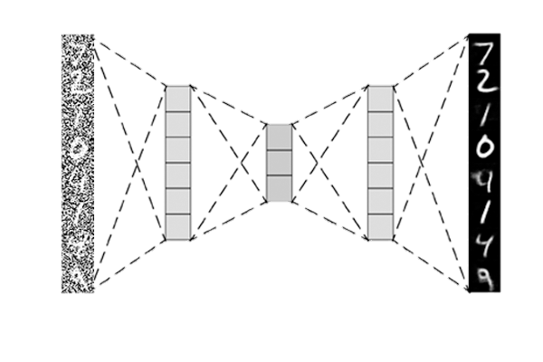
input
output
code
Encoder
Decoder
Detailed process of denoising the dataset by autoencoder

Slide 9
DATASETS
Proposed framework is validated on several datasets in different languages and compare them with different state-of-art algorithms:
Publicly available handwritten datasets in English.
We also trained and tested our systems on three Indic script datasets with different challenges: Devanagari (Hindi),English and Telugu.
These datasets comprises of noisy and old degraded documents along with new printed books, accordingly offering a diverse set of recognition challenges.
In order to make the system robust to low-resolution document images, we down sampled the high resolution images and used it as input to our system.
All the documents are bilingual with English as the second script, and there are few pages which comprise of handwritten paragraphs as well making segmentation tough task.
Before providing image as input to the framework skew correction and text graphics segmentation is performed.
These datasets are splitted as: training (60%), validation (20%) and test (20%). The training dataset was utilized for learning robust document image enhancement and recognition.
Alongside the noise already present in the image, Gaussian [G (variance: 0.01 and 0.1)] and salt-and pepper [(SnP density: 0.01 and 0.1)] noises are added to LR noisy image.

Slide 10
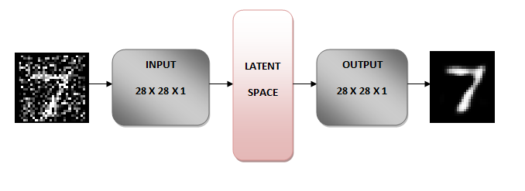
METHODOLOGY
Image denoising:
Fig .3 Denoising the image
Denoising autoencoders are an extension of simple autoencoder; however, it’s worth noting that denoising autoencoders were not originally meant to automatically denoise an image.
Instead, the denoising autoencoder procedure was invented to help:
The hidden layers of the autoencoder learn more robust filters
Reduce the risk of overfitting in the autoencoder
Prevent the autoencoder from learning a simple identify function

Slide 11
A great example would be pre-processing an image to improve the accuracy of an optical character recognition (OCR) algorithm. If you’ve ever applied OCR before, you know how just a little bit of the wrong type of noise (ex., printer ink smudges, poor image quality during the scan, etc.) can dramatically hurt the performance of your OCR method. Using denoising autoencoders, we can automatically pre-process the image, improve the quality, and therefore increase the accuracy of the downstream OCR algorithm.

Slide 12
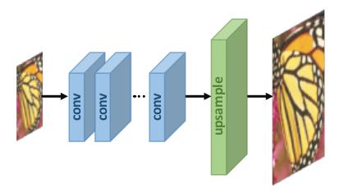
Image super-resolution:
An Autoencoder is just an unsupervised neural network that by design learns how to reduce data and reconstruct it losing as little data as possible.
It consists of an encoder and a decoder as you might have guessed. The role of the encoder is to compress the data to a lower dimension in a way that only the most influential features persist like PCA and the role of the decoder is to reconstruct the data from the lower-dimensional representation to as close it can get to the original.
In this image super-resolution process the image with low resolution is sent through the model and produces the image with high resolution.
If denoising and super resolution are done separately some of the spatial and temporal relationships are lost. Hence in this project we are performing it simultaneously.

Slide 13
Joint Optimisation of Denoising and Super-resolution:
We initialize the end-to-end coupled network for joint optimization of denoising and super-resolution of degraded document images by taking pre-trained weights of network 1 and network 2 as shown in Fig. 2. We consider pre-trained weights as initial weights to fine tune the combined network into an end-to-end manner.

Slide 14
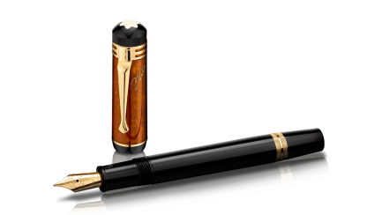
EXPERIMENTAL RESULTS
Table shows the recognition accuracy for all the 4 datasets. We compare the results of end-to-end trainable proposed framework with results from HR image, LR-4x, LR-3x, and other cascaded networks of denoising, followed by super-resolution and OCR.
For each dataset, the LR images suffered a lot in terms of recognition accuracy.
Individually trained models when cascaded together carry their errors, thus affecting the final recognition rates.
To demonstrate performance of the OCR part, we shown in Table the comparison between end-to-end trained proposed framework, cascaded modules of our framework and our enhancement module cascaded with Tesseract [18].

Slide 15
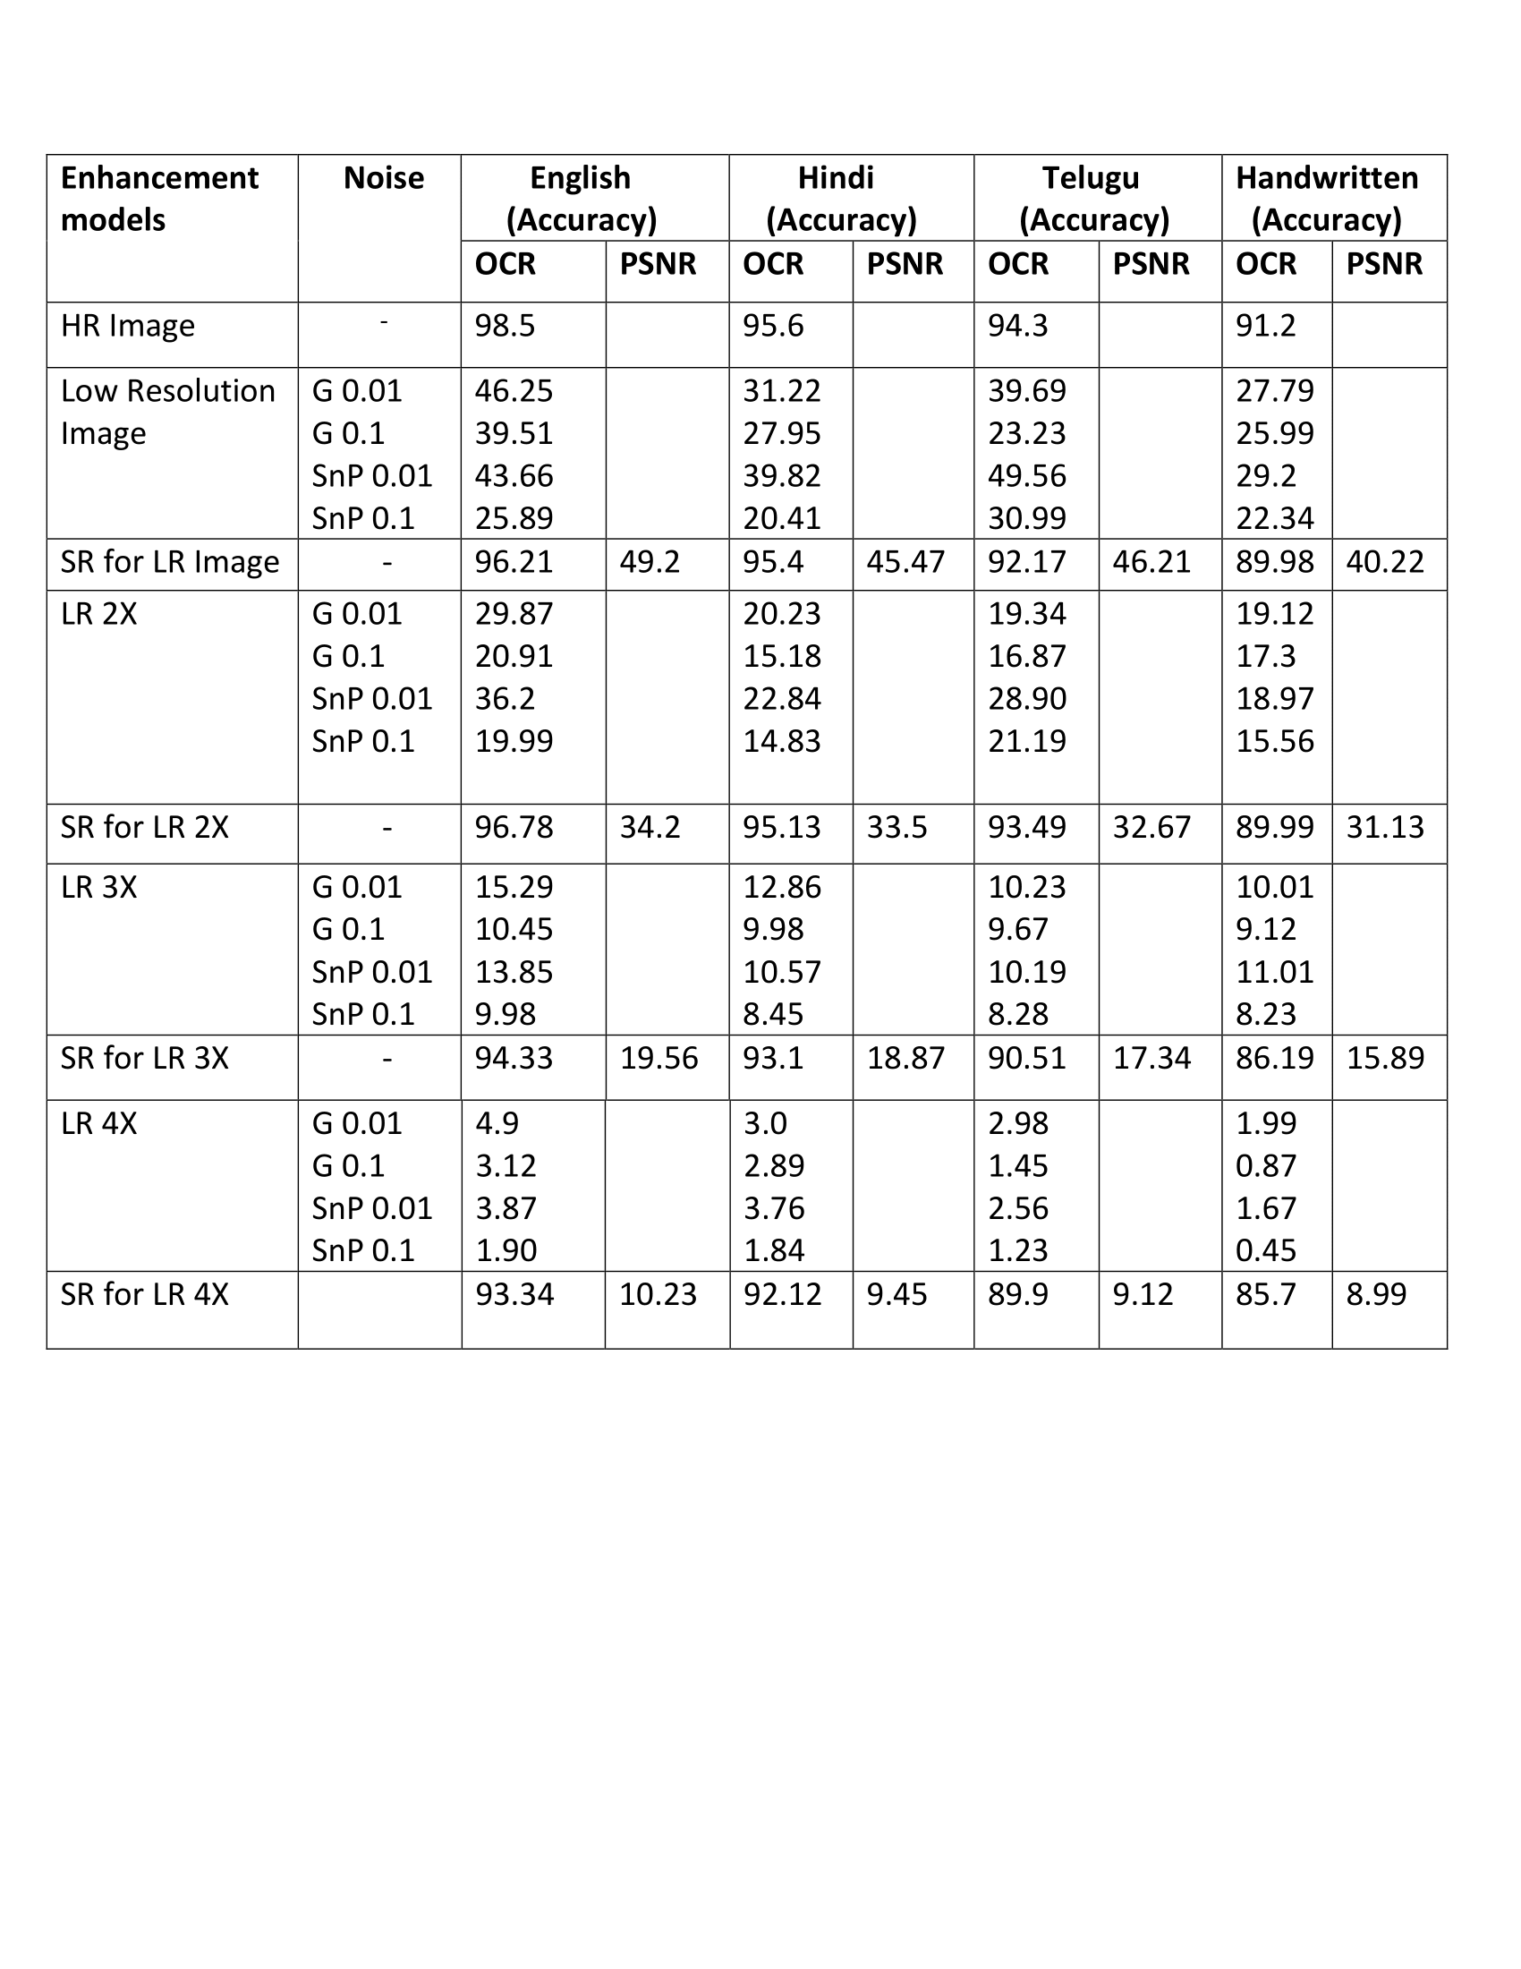
TABLE: COMPARISON OF PROPOSED ENHANCEMENT AND RECOGNITION FRAMEWORK ON OCR ACCURACY.

Slide 16
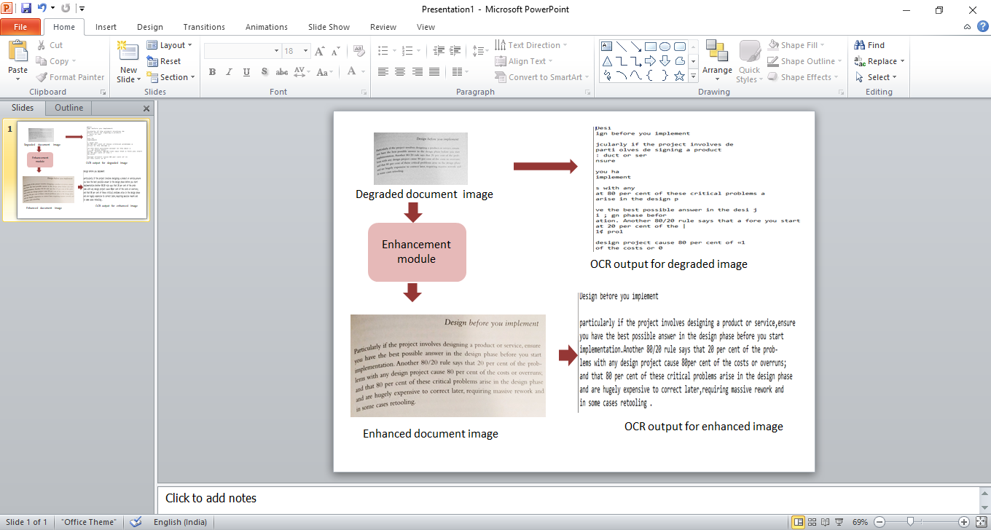
figure: OCR performance comparison between Degraded and Enhanced Document image

Slide 17
CONCLUSION
Exhaustive comparison of our model with other state-of-the-art models have been depicted in our paper.
End-to-End trainable network that jointly optimizes image enhancement and text recognition would make a high-performing robust OCR system.
Our model performed exceptionally well and showed the robust and efficient performance over printed and handwritten low-resolution de-graded document images.
We have achieved the state-of-the-art result over both printed and handwritten datasets for English as well as three Indic Scripts.

Slide 18
REFERENCES
J. Banerjee, A. M. Namboodiri, and C. V. Jawahar, “Contextual restoration of severely degraded document images,” in IEEE Computer Vision and Pattern Recognition, 2009.
Prateek Sarkar, H. S. Baird, and Xiaohu Zhang, “Training on severely degraded text-line images,” in International Conference on Document Analysis and Recognition(ICDAR), 2003.
M. D. Gupta, S. Rajaram, N. Petrovic, and T. S. Huang, “Restoration and recognition in a loop,” in IEEE Computer Vision and Pattern Recognition (CVPR), June 2005.
Dmitry Datsenko and Michael Elad, “Example-based single document image super-resolution: a global map approach with outlier rejection,” Multidimensional Systems and Signal Processing, 2007.
Chao Dong, Ximei Zhu, Yubin Deng, Chen Change Loy, and Yu Qiao, “Boosting optical character recognition: A superresolution approach,” CoRR, vol. abs/1506.02211, 2015.
K. Donaldson and G. K. Myers, “Bayesian super-resolution of text in video with a text-specific bimodal prior,” in IEEE Computer Vision and Pattern Recognition (CVPR), 2005.
H. Zhang, D. Liu, and Z. Xiong, “Cnn-based text image super-resolution tailored for ocr,” in 2017 IEEE Visual Communications and Image Processing (VCIP), 2017.
Hiep Q. Luong and Wilfried Philips, “Robust reconstruction of low-resolution document images by exploiting repetitive character behaviour,” International Journal of Document Analysis and Recognition (IJDAR), 2008.
M. Sharma, A. Ray, S. Chaudhury, and B. Lall, “A noise resilient super-resolution framework to boost ocr performance,” in 2017 14th IAPR International Conference on Document Analysis and Recognition (ICDAR), 2017.

Slide 19
Christian Ledig, Lucas Theis, Ferenc Huszar, Jose Caballero, Andrew P. Aitken, Alykhan Tejani, Johannes Totz, Zehan Wang, and Wenzhe Shi,
“Photo-realistic single image superresolution using a generative adversarial network,” CoRR, vol. abs/1609.04802, 2016.
A. Graves, M. Liwicki, S. Fernndez, R. Bertolami, H. Bunke, and J. Schmidhuber, “A novel connectionist system for unconstrained handwriting
recognition,” IEEE Transactions on Pattern Analysis and Machine Intelligence, 2009.
Alex Graves, Santiago Fernandez, Faustino Gomez, and Jurgen Schmidhuber, “Connectionist temporal classification: Labelling unsegmented sequence data with recurrent neural networks,” in Proceedings of the 23rd International Conference on Machine Learning, 2006, ICML ’06.
Ankit Lal and C V. Jawahar, “Enhancing ocr accuracy with super resolution,” in ICPR 2018, 08 2018, pp. 3162–3167.
Jun-Yan Zhu, Taesung Park, Phillip Isola, and Alexei A. Efros, “Unpaired image-to-image translation using cycleconsistent adversarial
networks,” CoRR, vol. abs/1703.10593, 2017.
Xiao-Jiao Mao, Chunhua Shen, and Yu-Bin Yang, “Image restoration using convolutional auto-encoders with symmetric skip connections,”
CoRR, vol. abs/1606.08921, 2016.
Muhammad Haris, Greg Shakhnarovich, and Norimichi Ukita, “Deep back-projection networks for super-resolution,” CoRR, vol.
abs/1803.02735, 2018.
Urs-Viktor Marti and H Bunke, “The iam-database: An english sentence database for offline handwriting recognition,” International Journal on Document Analysis and Recognition, vol. 5, pp. 39–46, 11 2002.
R. Smith, “An overview of the tesseract ocr engine,” in International Conference on Document Analysis and Recognition, 2007, ICDAR.

Slide 20
Thank you

